Slide 1
ARP Covert Channel
Presented by
Iskander Nafikov
31/07/2025

Slide 2
Introduction:
Problem Statement
The Address Resolution Protocol (ARP) is essential for mapping IP addresses to MAC addresses in local networks. Since ARP operates mainly within a LAN and is often overlooked by security appliances focusing on higher-layer protocols, it frequently lacks proper inspection and logging. This oversight allows attackers to exploit ARP packets to transmit hidden messages or instructions.
In addition, ARP operates without encryption and authentication making it inherently insecure but trusted by most operating systems and switches. Therefore, it becomes even easier to exploit it for attackers.

Slide 3
Introduction:
Project Overview
To analyze the protocol’s structure and vulnerabilities that make it suitable for hidden data transmission.
To implement a solution that encodes and decodes hidden instructions inside ARP packets and executes them.
Test this solution in a simple network environment.
Evaluate its limitations and discuss the future work.

Slide 4
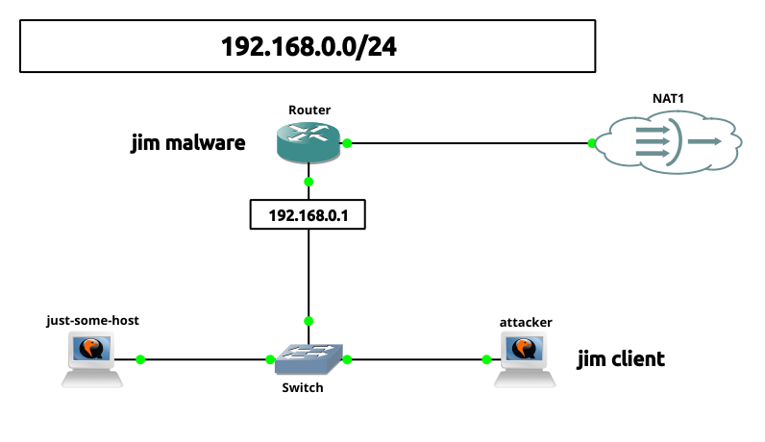
Methods:
Environment Setup

Slide 5
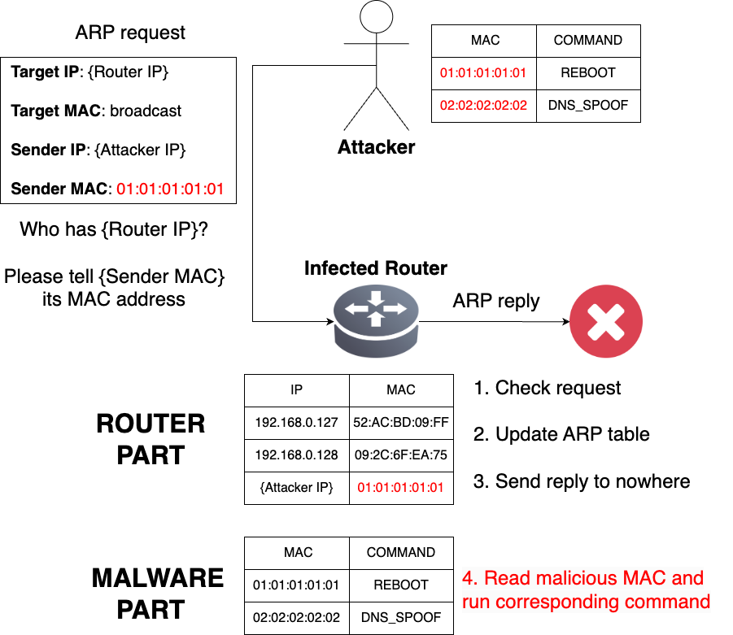
Methods:
Design

Slide 6
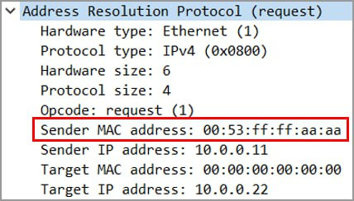
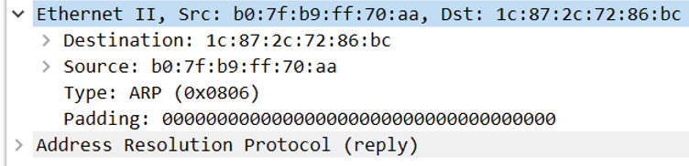
Methods:
Design
ARP packet analysis:
There are important fields in ARP that cannot be changed
Ethernet padding is the best choice to hide data but it’s too difficult or impossible to implement it
Field “Sender MAC address” is the most optimal choice

Slide 7
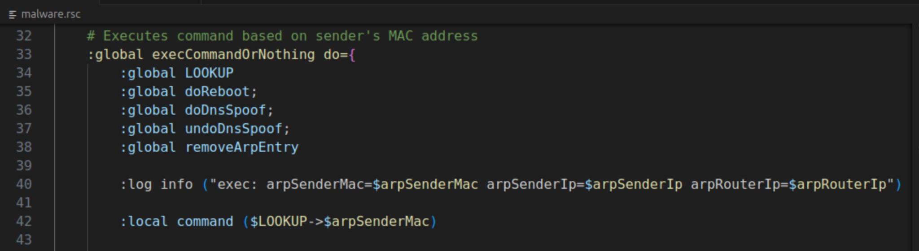
Results:
Proof of Concept
Demo: https://disk.yandex.ru/i/icALkCj0oc7XGA

Slide 8
Discussion:
Limitations & Future Work
Limitations:
Stateless communication: no ability to keep current state
Difficult to parametrize: fewer parameters fit into 6-byte field
Future Work:
Parametrization: stateful communication, usage of other fields
Obfuscation

Slide 9
Discussion:
Mitigation
Enable Dynamic ARP Inspection (DAI) to block unauthorized or spoofed ARP traffic. Or make ARP tables static…
Monitor and snapshot ARP table and look for unusual or unknown MAC addresses, especially those triggering repeated activity.
Use deep packet inspection and behavioral analysis tools to observe low-level anomalies.
Regularly audit system scripts, schedulers, and log entries to detect unauthorized automation or suspicious execution pattern.

Slide 10
Conclusion
In summary, ARP covert channels demonstrate how trusted protocols can be exploited for hidden communication.Though low in bandwidth, they pose serious security risks in LAN environments. However, stronger ARP monitoring and protocol-aware defenses are essential to detect and prevent such threats.

Slide 11
References
1. Definition of ARP: https://www.fortinet.com/resources/cyberglossary/what-is-arp
2. Definition of Covert Channel: https://en.wikipedia.org/wiki/Covert_channel
3. Packet format for ARP: https://www.geeksforgeeks.org/arp-protocol-packet-format/
4. Mikrotik Scripting Language: https://wiki.mikrotik.com/Manual:Scripting
5. Zeek Installation: https://docs.zeek.org/en/master/install.html
6. Zeek Scripting Language:
https://docs.zeek.org/en/master/scripting/basics.html#understanding-scripts
7. Wazuh installation guide: https://documentation.wazuh.com/current/installation-guide/wazuh-server/step-by-step.html

